Slide 1

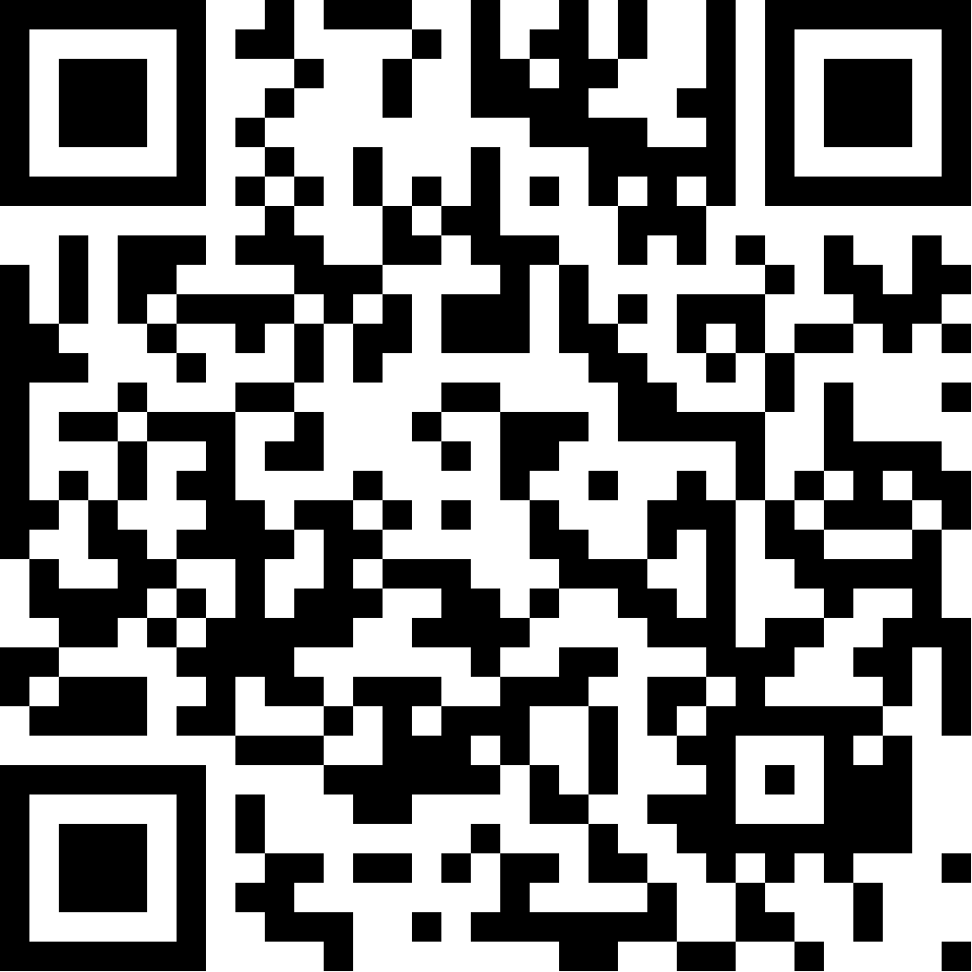
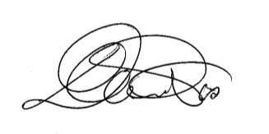


WEBINAR “ Sicurezza e Soccorso in spazi confinati”
Basato su Norme Standard NFPA – OSHA e Norm. 81
Durata: 4 Ore academiche vía On Line. Data: 06 di Lugio 2024
ROBUSTELLI VALERIA
Has ssucessfully completed
__________________________
Daniele Pes Director
Instructor NFPA- Pro Board
FP ASP440 0014

